Slide 1
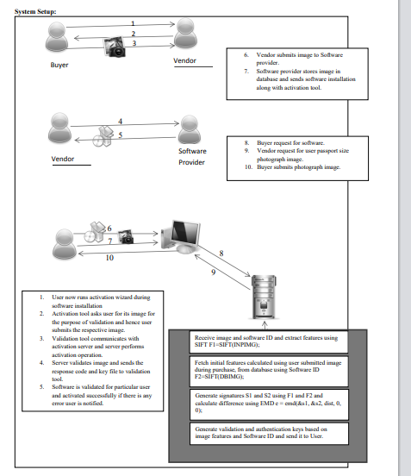

Slide 2
PHURCHASE PHASE (VENDOR)
ACTIVATION/INSTALLATION PHASE
Vendor request to purchase
software
Activation Centralized Server
Generated image features and software ID are stored in database
Vendor runs activation wizard during installation
Validation tool communicates with activation server and server performs activation operation.
Software Manufacturer request for vendor image.
Vendor re-submits the same image
Vendor submits image
Image sent to activation server along with user system properties.
Activation Centralized Server
Sends Activation Key, and Tracking Key to the Validation Tool
Image stored in a database
Vendor successfully activates the software
Architecture of the Existing System

Slide 3
Architecture of the Prosed System
PHURCHASE PHASE (VENDOR)
ACTIVATION/INSTALLATION PHASE
Vendor request to purchase
software
Activation Centralized Server
Generated image/fingerprint features and software ID are stored in database
Vendor runs activation wizard during installation
Validation tool communicates with activation server and server performs activation operation.
Software Manufacturer request for vendor image.
Vendor re-submits the same image
Software manufacturer request for vendor fingerprint
Vendor re-submits the same fingerprint
Vendor submits image and fingerprint
Image and fingerprint sent to activation server along with user system properties.
Activation Centralized Server
Activation Centralized Server
Sends Activation Key, Tracking Key and Branch Count Value to the Validation Tool
Image and fingerprint stored in a database
Vendor successfully activates the software

Slide 4
PHURCHASE PHASE (BUYER)
ACTIVATION/INSTALLATION PHASE
SOFTWARE PIRACY DETECTION (BUYER)
Activation Centralized Server
Enter Authentication Key
Buyer request to purchase
software
Generated image/fingerprint features and software ID are stored in database
Enter Branch Count Value
Submit
Buyer runs activation wizard during installation
Validation tool communicates with activation server and server performs activation operation.
Trained Detection Model
(hybridized Algorithm)
Activation centralized server
Vendor request for buyer passport size photograph image.
Buyer re-submits the same image
Buyer re-submits the same fingerprint
System Decision
Original Pirated
Vendor request for buyer fingerprint
Image and fingerprint sent to activation server along with user system properties.
Software Detection Result
Buyer submits photograph image
Activation Centralized Server
Vendor sends activation key and branch count value to the validation tool
Image and fingerprint stored in a database
Buyer successfully activates the software
Architecture of the Prosed System

